Slide 1

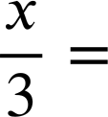
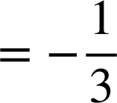
Many equations, one solution
Task A: Maintaining equality while manipulating equations
Complete the equations in this diagram. The arrows show the operation that is being applied to the whole equation.
_______ = _____
x + 1 = _____
+(−4)
+ (−5x)
_______ = 35
_____ + 1 = _____ + 5x
+ 1
× 5
_____ = 3 + 5x
x + 4 = ___
+ 5x
+ 4
x = 3
× 3
×
____ = 9
+(−10)
____
______ = −1
+ (x + 1)
÷ 3
________ =________
________

Slide 2
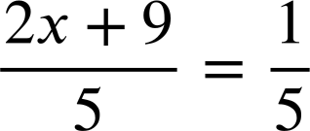

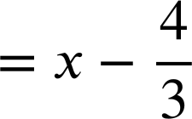
Many equations, one solution
Task B: Generating equations with the same solution
Fill in the missing expressions and operations in this diagram.
6 = ______
×
+ (−x)
_______ = 1
_______ = 2
____
____
2x = ____
_______ = 6
× 2
+ 10
x =___
+ 3x
_____ = 3x − 4
×
____
_____ =_____
8x = 7x − 4
+ x
+ 4
_______ ........
_______ = 7x
Mathematics in Education and Industry
v2.3

